Slide 1
Liver Disease Prediction and Analysis
Farah Tabassum Ahmed
1610431042

Slide 2
Introduction
Patients with Liver disease have been continuously increasing because of excessive consumption of alcohol, inhale of harmful gases, intake of contaminated food, pickles and drugs. This dataset was used to evaluate prediction algorithms in an effort to reduce burden on doctors.

Slide 3
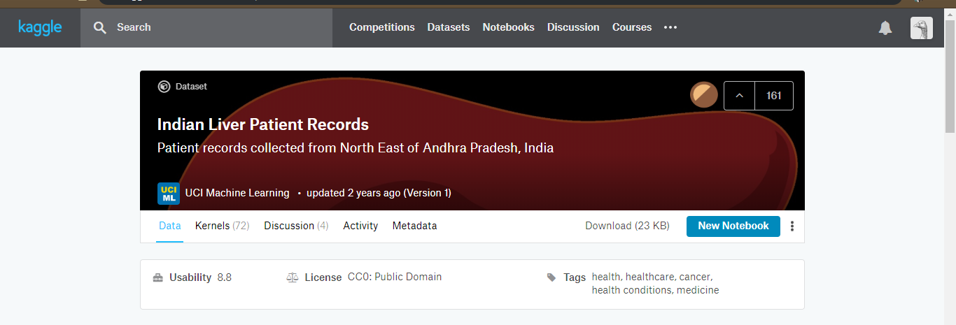
Dataset

Slide 4
Dataset
This dataset contains –
583 instances with 11 attributes.
441 male patient records and 142 female patient records.
416 liver patient records and 167 non liver patient records

Slide 5
Objective
Goal of this project was to build classifiers to predict whether a person(male/female) has a liver disease
In this case, I will have the target variable “Dataset (the predicted attribute)”.
i. Dataset = Value 1; means the person has liver disease
ii. Dataset = Value 2; the person does not have liver disease

Slide 6
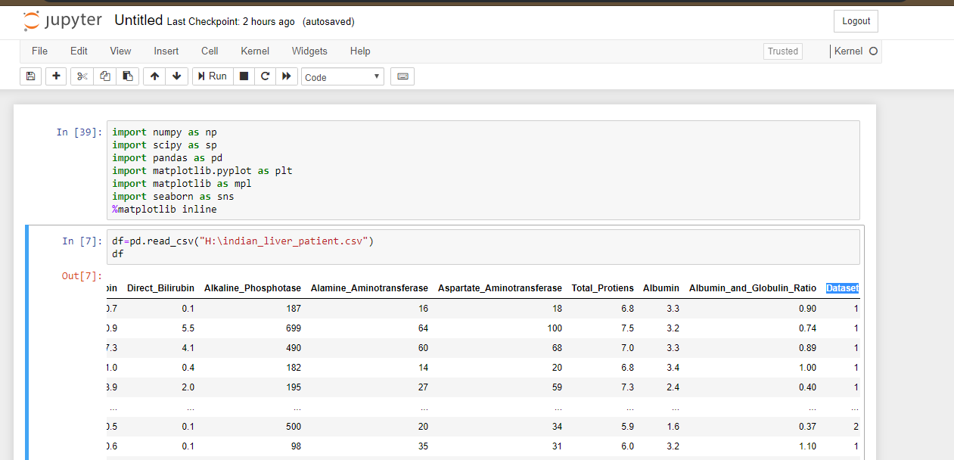
Works Update
Import necessary python
libraries
Read data
Data review
i. data.head
ii. Data.shape
iii. Data.describe

Slide 7
Works Update
Data preprocessing
check null values
Replace null values with the mean
value of that attribute
EDA (Exploratory data analysis)

Slide 8
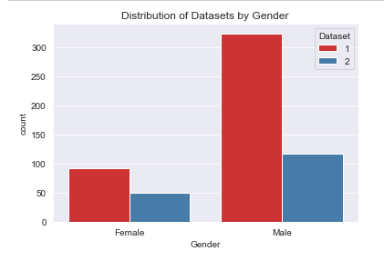
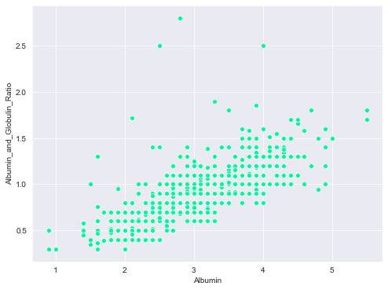
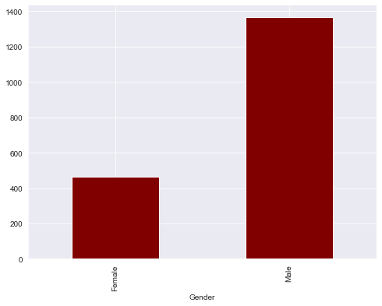
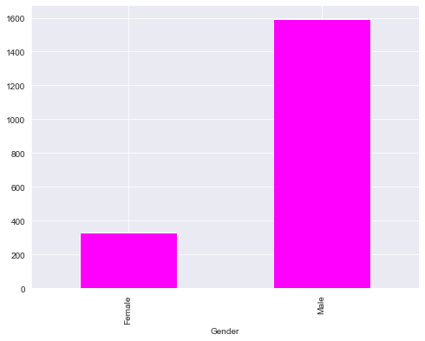

Slide 9
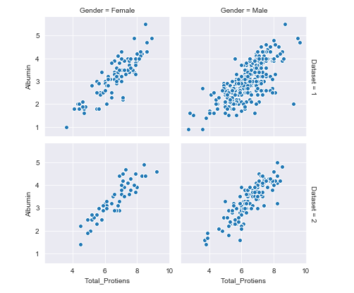
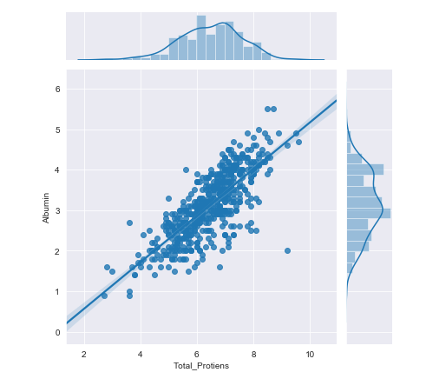
Scatter plot between total_protein and albumin and got linear relationship

Slide 10
Works Update
From the above jointplots and scatterplots, we find direct relationship between the following features: Direct_Bilirubin & Total_Bilirubin Aspartate_Aminotransferase & Alamine_Aminotransferase Total_Protiens & Albumin Albumin_and_Globulin_Ratio & Albumin
Hence, we can very well find that we can remove one of the features. I'm going to keep the follwing features: Total_Bilirubin Alamine_Aminotransferase Total_Protiens Albumin_and_Globulin_Ratio Albumin

Slide 11
Problem Faced
Pointing out the relations of the attributes with the Class value
Problem faced while understanding correlation matrix
Problem faced while applying algorithms

Slide 12
Future Work
Split the dataset in training and testing set
Evaluate the trained model by test set
Apply confusion matrix
Apply different supervised classifier like linear regression, decision tree, Random forest
Apply neural network
Check accuracy
Find the best classifier among all

Slide 13
Thank you

